Slide 1
Impact Prediction
Part-I

Slide 2
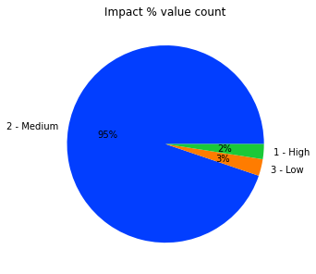
IT Tickets priority
Objective: Predict High Impact tickets to Prioritise.
Use-case: Auto-predict high impact tickets &
notify IT team to verify it.
Relevant observations:
95% of tickets are medium priority.
  Disproportionate
Document knowledge
  High Impact Tickets - No document knowledge
  Medium Impact Tickets - 20%
  Low Impact Tickets - 40%
30% of tickets are opened by Group 17
30% of tickets are handled by Support-group 70
Most affected services categories are,
  Category 26 - 13%
  Category 53 - 11%
  Category 42 - 11%
  Category 46 - 10%

Slide 3
IT Tickets priority
Solution:
ML Classification model to identify high impact tickets
  Two Groups (Low+Medium) & High impact tickets
Inputs to predict High Impact:
  ID - Incident identifier
  Category ID - First-level description of the affected service
  Opened Time - Incident user opening date and time
Results:
  Precise Model:
    How many High impact tickets are retrieved of total High Impact tickets - 71% (Recall)
    How many retrieved High impact tickets are True - 85% (Precision)
  Recall Model: - Recall is more important here
    How many High impact tickets are retrieved of total High Impact tickets - 89% (Recall)
    How many retrieved High impact tickets are True - 36% (Precision)
Use of this approach: Save time to resolve High impact tickets.
Notes:
Medium impact ticket account for 95% of tickets
Hence we include 3% Low priority in medium to facilitate predicting

Slide 4
Impact Prediction
Part-II

Slide 5
Questions
a) What would be your next steps if IT team likes your PoC from part 1?
Create Git repo, commit dev codes.
Implement collect feedback from IT team.
Retrain model with more data & Validate it against current real data.
Track Experiments (MlFlow, Dagshub etc.,)
b) IT team would like to understand if they can utilize ML/AI for other processes. Think about use-cases and problems that could be solved by ML capabilities, list your ideas. (Base your ideas on provided dataset).
Predict problem ID using ticket data which may help IT Team.
Suggest which support group & Support incharge the ticket should be assigned.
Predict Documents to refer based on ticket details.
c) How would you productionize suggested solution?
Fast API in containers for backend.
Create CD pipeline (Jenkins, Azure etc.,)
Create simple internal web app. To be validated by
few selected IT members (Control group) Vs the existing process group, validate if it improves efficiency.
If the tools is useful provide APIs to be integrated with existing dashboards & tool.
Model monitoring pipeline (measure data & Model drift) cron job with auto notification.
  Data Drift - KS Test
  Model drift - F1 score/recall

